Slide 1
Relation Classification via Multi-Level Attention CNNs
Reference: ACL 2016
Zhongxuan Xue

Slide 2
Summary of relation extraction
Definition：the task of identifying the semantic relation holding between two nominal entities in text.
e1
e2
Eg:“Fizzy [drinks] and meat cause heart disease and [diabetes].”
Cause-Effect(e1,e2)

Slide 3
Main research methods
IS-A:
“Y such as X ((, X)* (, and|or) X)”! “such Y as X”! “X or other Y”! “X and other Y”! “Y including X”! “Y, especially X”!
Hand-built Patterns（基于规则的模式匹配）
Supervised Method（有监督学习的方法）
Seed-­based or bootstrapping approach（基于种子的启发式算法）
Semi-supervised && unsupervised（半监督和无监督学习方法）
Distant Supervision（远程监督学习）
If two entities participate in a relation, all sentences that mention these two entities express that relation.
http://www.fanyeong.com/2018/08/11/relation-extration-overview/

Slide 4
Source of inspiration
a multitude of different ways of expressing the same kind of relationship.
feature-and kernel-based approaches（rely on a full-fledged NLP stack）
deep architectures(CNN / RNN) （often fail to identify critical cues, and many of them still require an external dependency parser）
Multi-Level Attention CNN

Slide 5
Key contributions
→Multi-Level Attention CNN(capture both entity-specific and relation-specific)
→A novel pair-wise margin-based objective function
→Obtain the new state-of-the-art results with an F1 score of 88.0% on the SemiEval 2010 Task 8 dataset
19 types（2 × 9 + 1）
Train data：8000
Test data：2717
1 | The <e1>microphone</e1> converts sound into an electrical <e2>signal</e2>.
2 | Cause-Effect(e1,e2)
3 | Comment:

Slide 6
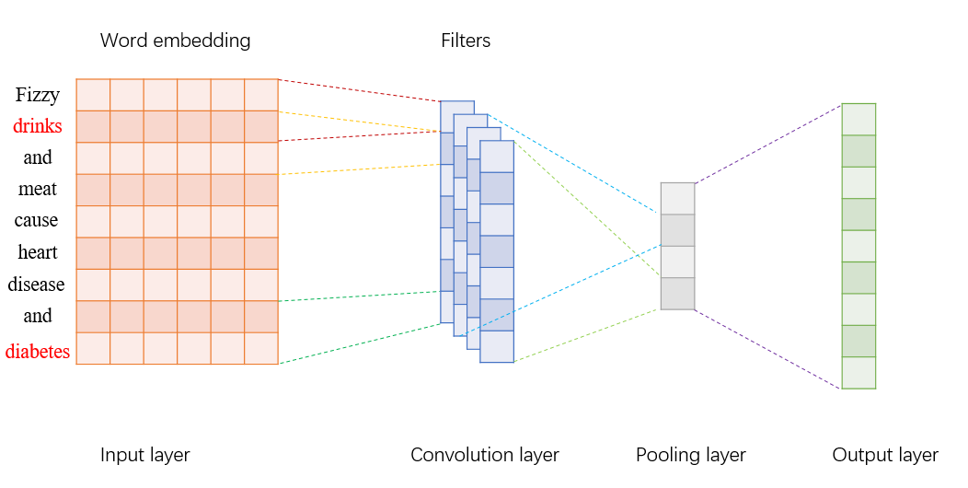
relation classification architecture
Secondary Attention
Primary Attention
capture the relevance of words and the target entities.
determine the most useful convolved features for relation classification

Slide 7
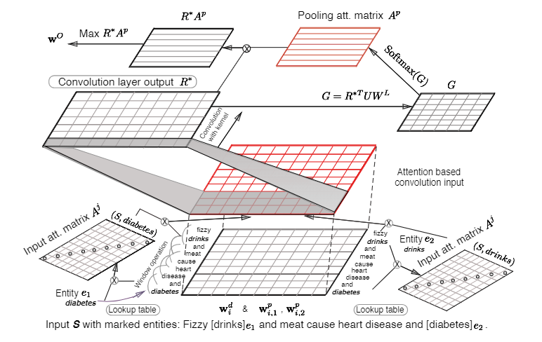
Schematic overview of Multi-Level Attention Convolutional Neural Networks

Slide 8


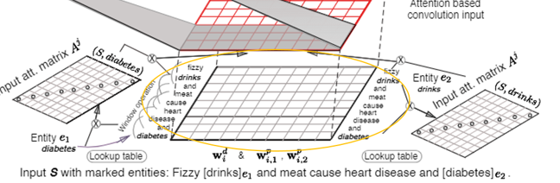
Input Representation
-1
6
S= (w1,w2,...,wn)
Fizzy [drinks] and meat cause heart disease and [diabetes].
word embedding + position embedding
the relative distances of word “and” to e1“drinks” and e2“diabetes” are −1 and 6.
(Relation Classification via Convolutional Deep Neural Network)
Word2vec skip-gram
incorporate contextual information
k:a sliding window of size k centered around the i-th word
$$if k=5 then z_{and}=[w_{Fizzy},w_{drinks},w_{and},w_{meat},w_{cause}]$$

Slide 9
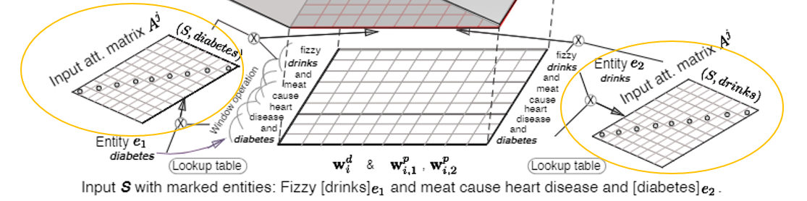






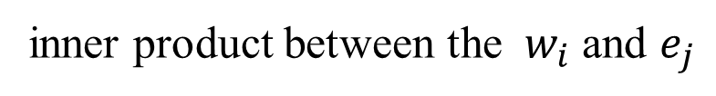

Input Attention Mechanism
diagonal attention matrices
$$A^{j} ( j=1,2 )$$
$$A_{i,i}^{j}=f(e_{j},w_{i})$$
inner product between the ${ w}_{i}$ and $e_{j}$
quantify the relative degree of the i-th word and the j-th entity
$$R=[r_{1},r_{2},…,r_{n}]$$
the input of CNN

Slide 10
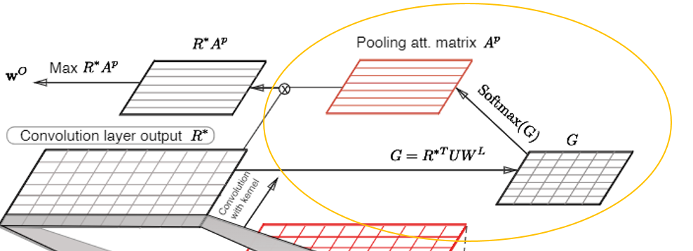




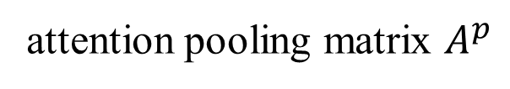
Convolutional Max-Pooling with Secondary Attention
Convolution Layer
Attention-Based Pooling
captures pertinent connections between the R* and the WL(relation class embedding )
attention pooling matrix $A^{p}$
highlight important individual phrase-level components, and select the most salient one

Slide 11
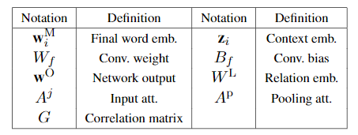

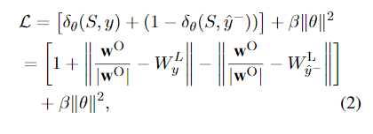

Classification Objective
score distance function：
margin function：

Slide 12
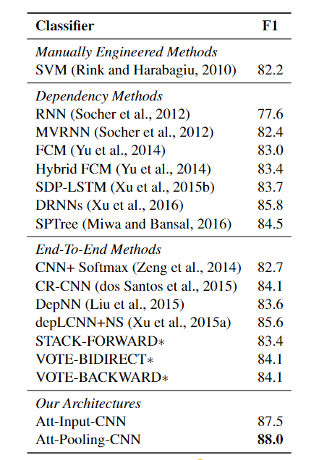
Experiments

Slide 13
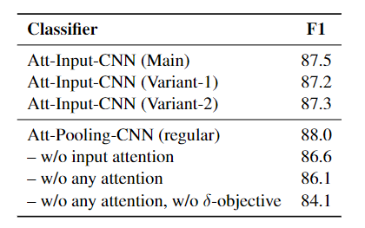

Experiments
Without input attention
Without input attention and pooling attention
Without input attention , pooling attention and distance function

Slide 14
The end
Zhongxuan Xue
2020/9/14

Slide 15
Q & A
DATASET
Cause-Effect
Component-Whole
Content-Container
Entity-Destination
Entity-Origin
Instrument-Agency
Member-Collection
Message-Topic
Product-Producer
“Other”

